Slide 1
ARABLE

Slide 2
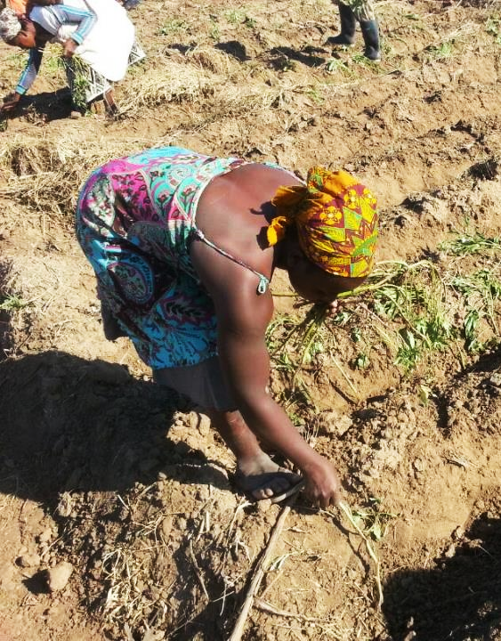
INCREASING SMALLHOLDER RESILIENCE WITH AGRONOMY ADVISING & INSURANCE
500 million smallholder farmers produce 80 percent of the food consumed by the developing world.
Every five years a catastrophic event wipes out any savings generated and prevents long-term investment and growth.
WFP has shown access to innovative insurance helps maintain food security compared to others exposed to the same risks.

Slide 3
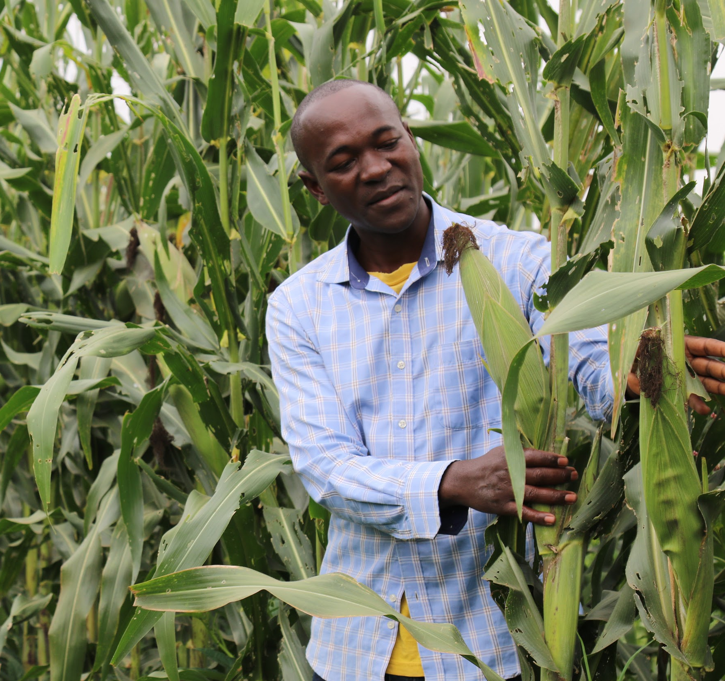
SMALLHOLDER CONTEXT IN MOZAMBIQUE
Agriculture accounts for the income of over 70 percent of the population.
In 2019, Mozambique was the most impacted country by extreme weather events, globally.
Recurring emergencies have eroded capacity to manage recurring shocks, with recent events requiring $3B for recovery.
Notes:
(Global Climate Risk Index 2021), Germanwatch report 2021, https://germanwatch.org/en/19777#:~:text=The%20Global%20Climate%20Risk%20Index,%2C%20heat%20waves%20etc.).&text=The%20countries%20and%20territories%20affected,as%20well%20as%20the%20Bahamas.
PDNA- Post Disaster Needs Assessment

Slide 4
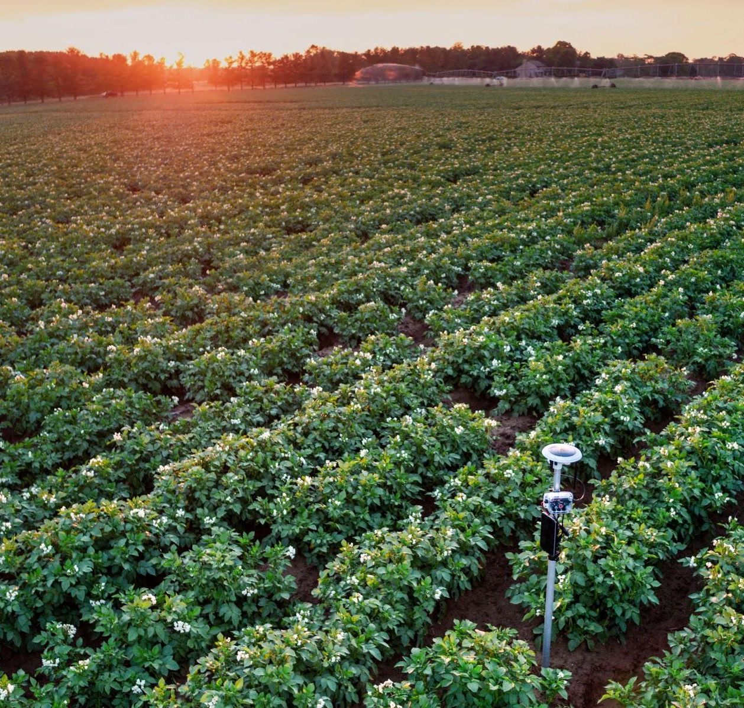
INTRODUCING ARABLE
40+ measurements on climate and crop.
2kg weight = easy to ship and highly portable.
Connects via cellular network.
Provides forecasts, weather and crop timing alerts to improve decision making.
Communicates through SMS, web interface and APIs.

Slide 5
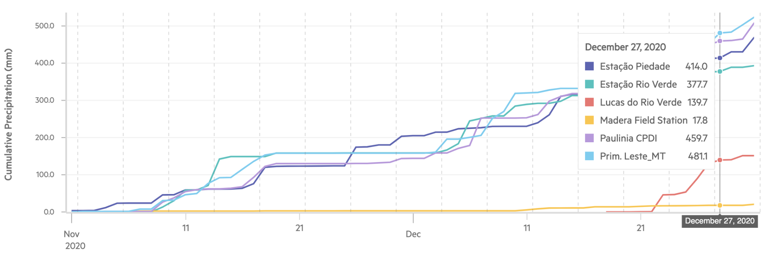
CAPTURE REAL-TIME PRECIPITATION VARIABILITY
Field A
Field B
Field C
Field D
Field E
Field F
Precipitation during critical growth stages is fundamental to achieving yield outcomes.
Identify field-by-field or regionally, where poorly timed precipitation impacts access to staple crops.

Slide 6
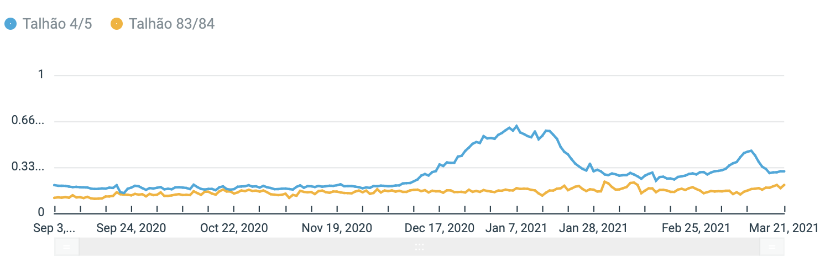
TRACK REAL-TIME CROP PRODUCTIVITY & HEALTH
Field A
Field B
Expected Germination
Verify emergence across field locations to understand need to replant or risk of sub-optimal yields.
Monitor key indicators for disease and pest risk to control impact on yield outcomes.

Slide 7
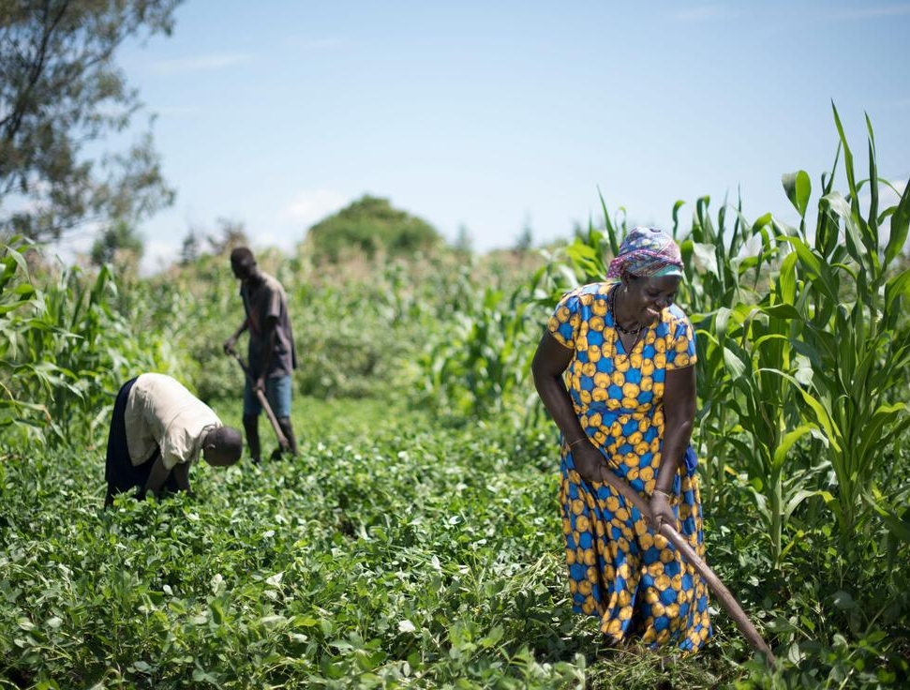
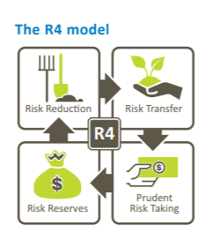
DATA FEEDS AGRONOMIC ADVISORY & INSURANCE
COLLABORATING PARTNERS
*CONTRACTED INSURANCE COMPANY
Arable data serves WFP R4 Resilience Program and climate advisory bulletins.
Improves agronomic advising through collaborating partners and insurance offering.
Reaches 87,000 smallholders to increase climate resilience, yield outcomes and food security.

Slide 8
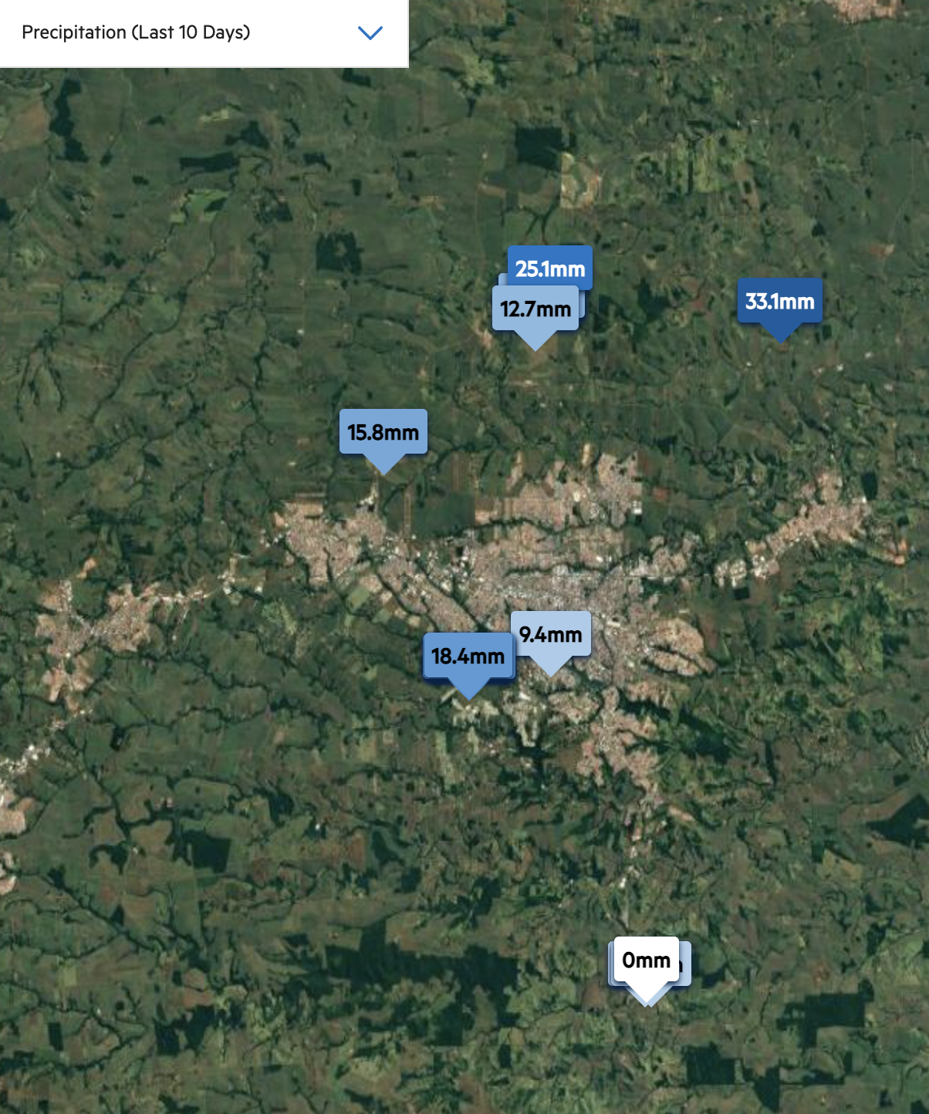
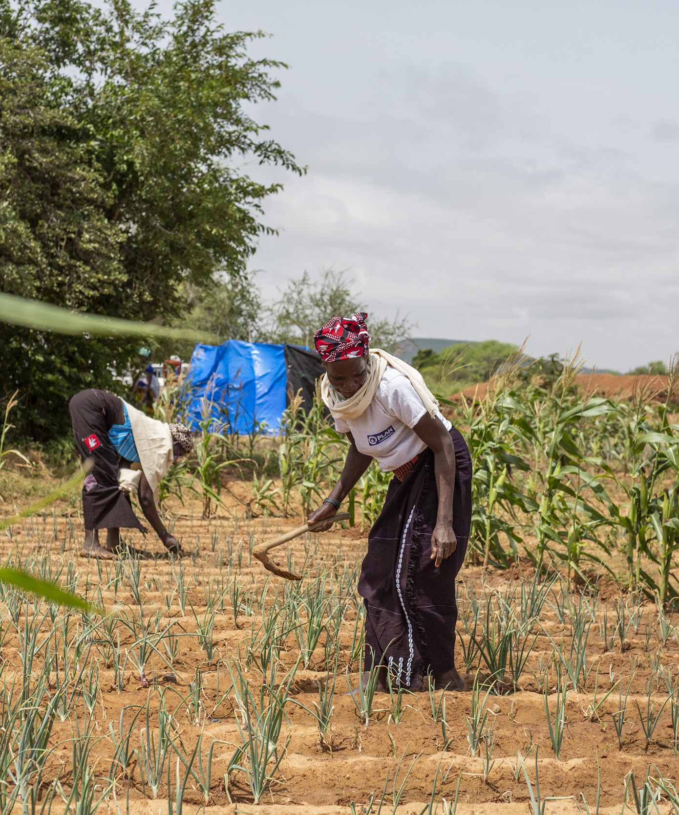
$100K FOR PROOF OF CONCEPT TO REACH INITIAL 3,814 BENEFICIARIES
*CONTRACTED INSURANCE COMPANY
30% to In-Field Sensors
30 Arable Crop & Climate Monitors
Sited to sample and track staple crops and climatological features
70% to Data Pipeline
Experts in M&E, insurance design, agronomic advising and meteorology.
Reaching Three Districts in Mozambique:
Gaza: 2,218 farmers (88% women)
Tete: 1,596 farmers (64% women)

